Slide 1
Debugging and Logging

Slide 2

Notes:
When we start writing code, one of the best ways to catch errors is to dump some form of debugging text to a console (using print in Python or printf / cout in c++). Then we learn to use a debugger, so we can set breakpoints and watch the code work (or not) line by line – and that gives us another tool in our fight to write error free code.
But it’s not a tool that outright replaces the printing of debugging text, with some refinements, we can make just as much use of text outputs as we do the debugger. Often it’s the only way we can identify an issue – some bugs are timing dependant and only happen when the game is running at full speed, others are complicated sequences of events that are too difficult to trace through line by line.

Slide 3
Notes:
But, before we get onto that, let’s talk about the options the debugger provides us:
So we hit F5 and Visual Studio will start debugging our code – even if we’re in release mode, which makes debugging quite difficult (though there are still things we can do to see what the code is doing).
Breakpoints – F9 set breakpoint, F10 step over, F11 step into
Call stack – double click entries to see the code at that point.
Watch Window – type variables, call functions,
The “,d” suffix forces values to be displayed in decimal notation.
The “,x” suffix forces values to be displayed in hexadecimal notation.
The “,n” suffix (where n is any positive integer) forces Visual Studio to
treat the value as an array with n elements. This allows you to expand
array data that is referenced through a pointer.

Slide 4
Notes:
We can also specify “data breakpoints”, which let us watch specific memory addresses and trigger the breakpoint when that address is written to. Sometimes they’re called “hardware breakpoints” as they use a special feature of the CPU.
This can be used to track down problematic issues such as a variable being assigned an incorrect value – we punch in the memory address to a data breakpoint and when that location is modified, the breakpoint is hit and we can track down the offending function that’s causing our problems.
Finally, we can set conditions on the breakpoints – so we can stop them from triggering every frame or for every loop. Conditional breakpoints trigger an evaluation of a c++ statement entered into the breakpoint options, so we could check if a variable is a specific value or if the internal “this” pointer is pointing to the address of a specific instance.
Another condition we can set is a hit count – which causes the debugger to decrement a counter every time the breakpoint is hit, only stopping the program when the counter hits 0. This is pretty ideal for breaking in the middle of a huge loop – rather than hitting F10 hundreds of times, we can just set a hit count for the loop number we want to check.

Slide 5
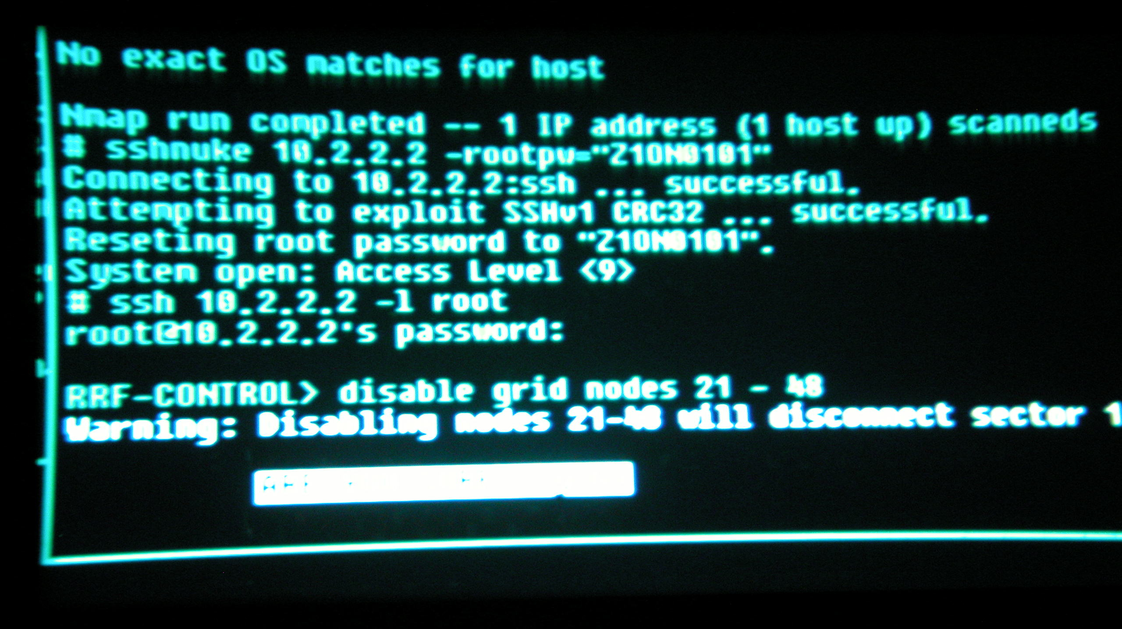
Notes:
Most modern platforms provide access to a console or teletype (TTY) output device:
Linux, Windows and Mac all allow production of output by printing to stdout or stderr, though these won’t work if we’re building our game as a win32 application – in which case we can print to the visual studio debug console using OutputDebugString.
For console development, there’s often a set of output windows that can receive (and display) messages sent by the game engine running on the development kit (this is provided by the Target Manager or Playstation Neighbourhood application for PS3/PS4 developers).
Just outputting text is fine, but we can elevate this approach to allow us much more granular control over our outputs while also making them easier to read and locate important errors.

Slide 6
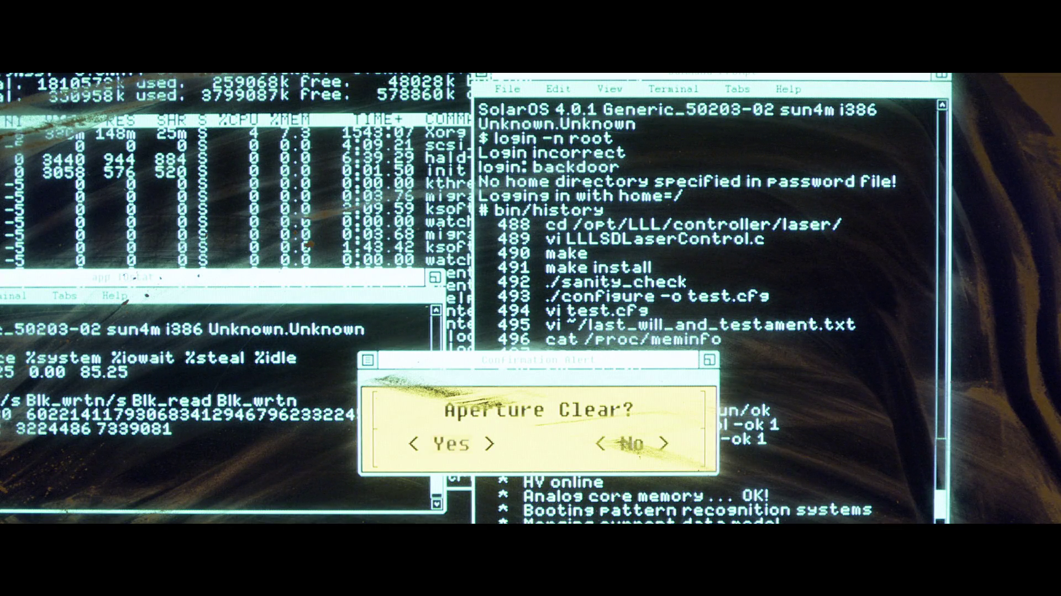
va_list represents a variable argument list.
Declare a buffer of max_char size.
int VDebugPrintF(const char* format, va_list argList)
{
const unsigned int MAX_CHARS = 1024;
static char s_buffer[MAX_CHARS];
int charsWritten = vsnprintf(s_buffer, MAX_CHARS, format, argList);
OutputDebugStringA(s_buffer);
return charsWritten;
}
Store the formatted string in the char buffer
Send the buffer to the output console
Return the number of characters written.
Notes:
OutputDebugString will be our starting point, but we have an issue in that it does not support formatted output – it can only output raw strings as arrays. This sucks, as it means it’s hard to easily drop useful information into our debugging messages.
But, there is a way around this – we can write our own functions that wrap OutputDebugString, allowing us to take a formatted string and output it with OutputDebugString.
Our basic wrapper looks like this:

Slide 7
The ellipses (…) represent our variadic arguments
Create a variable argument list
int DebugPrintF(const char* format, ...)
{
va_list argList;
va_start(argList, format);
int charsWritten = VDebugPrintF(format, argList);
va_end(argList);
return charsWritten;
}
Call our original debug print, passing in our argument list.
Passing a string and list of arguments to the function.
DebugPrintF("System::Initialize, %d, %d, %f\n", 10, 15, 52.3f);
Notes:
We can expand the usability of our VDebugPrintF function by writing a further wrapper:
The ellipses make our usage easier – we don’t need to build a variable argument list, we can just call the function and supply a list of arguments:

Slide 8

Info
Non-vital debugging messages that provide useful information about the state of our system.
Warning
Issues that don’t impact the running of the system, but may need resolving to stop future issues.
Error
Catastrophic failures that need to be fixed immediately.
Notes:
We also want the ability to filter our logging output – we might only want to log everything while we’re developing the engine, once the game is out, we can probably ignore statements that are informational or just warnings rather than serious errors.
So we might want to declare “levels” for our debug messages:

Slide 9
We pass in the verbosity of the log message
We list all our verbosity levels
int VerboseDebugPrintF(int verbosity, const char* format, ...)
{
if (g_verbosity < verbosity)
return 0;
va_list argList;
va_start(argList, format);
int charsWritten = VDebugPrintF(format, argList);
va_end(argList);
return charsWritten;
}
enum Verbosity
{
None,
Error,
Warning,
Info,
All
};
We drop the log if the verbosity is too high.
Otherwise, we log as normal.
Notes:
As a starting point, we can use an enumeration to represent these levels, so we can specify a verbosity level and let that control which messages actually get printed.
Note that the verbose debug logger is nearly identical to the last function we looked at – so we can say that the last version guarantees a message is logged, no matter what.
The g_verbosity variable is global (but not static) – to declare this, we use the “extern” key word in the header file and then declare the variable again in a cpp file. After that, we can use it anywhere the header file is included.

Slide 10
{
"categories": {
"error": {
"write_to_file": 1,
"write_to_console": 1
},
"animation": {
"write_to_file": 1,
"write_to_console": 0
}
}
}
void Logger::Init()
{
// …
std::string tag(pNode->Attribute("tag"));
unsigned char flags;
int debugger = 0;
pNode->Attribute("write_to_console", &debugger);
if (debugger)
flags |= 1 << 0;
int logfile = 0;
pNode->Attribute("write_to_file", &logfile);
if (logfile)
flags |= 1 << 1;
SetDisplayFlags(tag, flags);
}
All the file loading code goes here
Pull the category / tag name
Use bit shifting to set the first bit in flags
<?xml version="1.0" encoding="UTF-8" ?>
<categories>
<error>
<write_to_file>1</write_to_file>
<write_to_console>1</write_to_console>
</error>
<animation>
<write_to_file>1</write_to_file>
<write_to_console>0</write_to_console>
</animation>
</categories>
SetDisplayName updates the map with the new tags.
Set the second bit in flags
Notes:
Further filtering can be achieved by allowing the category of the log to be included; we may want to specify the system that the message comes from. We could expand the verbosity enum, but that restricts our ability to combine categories and makes it more complicated to expand the system.
What we can do is store our categories in a config file, which will dictate the name of the category and gives us the option of specifying if, by default, the category should be printed to the console and / or printed to a debug file.
We can represent these categories using a hash map (or dictionary) which maps the category string value with an int (or char) that we can set specific bits in to signify how to treat that category.

Slide 11

Logger* Logger::_instance = NULL;
Logger* Logger::instance()
{
if (!_instance)
{
_instance = new Logger();
_instance->Init();
}
return _instance;
}
private:
static Logger *_instance;
public:
static Logger *instance();
WriteToFile accepts the finalised debug string
void Logger::WriteToFile(const std::string &buffer)
{
FILE *logFile = NULL;
fopen_s(&logFile, "error.log", "a+");
if (!logFile)
return;
fprintf_s(logFile, buffer.c_str());
fclose(logFile);
}
Setup a file pointer
Attempt to open it with the append flag.
If it exists, write to it and close it
Logger::instance()->WriteToFile("testing message!");
Notes:
Writing to a debug file is pretty straight forward:
We would probably want to do something sensible like make the filename into a const value that we set in the header.
By making our Logger class a singleton, we can access it from anywhere and guarantee that we only ever have one instance of it at any given moment in time.

